Slide 1
HiPEAC Webinars – February 15, 2022
Climbing EVEREST: dEsign enVironmEnt foR Extreme-Scale big data analyTics on heterogeneous platforms
Gianluca Palermo
Politecnico di Milano

Slide 2
EVEREST: Big Data Processing on FPGA
H2020 project funded under the call – "Big Data technologies and extreme-scale analytics" [Kick-off on Oct 1, 2020][http://www.everest-h2020.eu]
Big focus on FPGA acceleration in data centers and associated issues
Key idea:
a coordinated action with the appropriate technology areas (e.g., AI, analytics, software engineering, HPC, Cloud technologies) ➔ FPGA acceleration in (federated) data centers
system engineering/tools to contribute to the co-design of federated/distributed systems ➔ EVEREST system development kit
adaptive memory management
architectures for collecting,
managing and exploiting data
domain-specific extensions
data security
hardware acceleration
high-level synthesis
virtualization
autotuning and dunamic adaptation
runtime management

Slide 3









EVEREST Partners
IBM Reseach Lab, Zurich (Switzerland)
Project coordination, prototype of the target system
Politecnico di Milano (Italy)
Scientific management, high-level synthesis, flexible memory managers, dynamic autotuning
Università della Svizzera italiana (Switzerland)
Data security requirements and protection techniques
TU Dresden (Germany)
Domain-specific extensions, code optimizations and variants generation
Virtual Open Systems (France)
Virtualization techniques, runtime extensions to manage
heterogeneous resources
IT4Innovations (Czech Republic)
Exploitation leaders, HPC infrastructure, workflow libraries
Centro Internazionale di Monitoraggio Ambientale (Italy)
Weather prediction models
Duferco Energia (Italy)
Application for prediction of renewable energies
Numtech (France)
Application for monitoring the air quality of industrial sites
Sygic A/S (Slovakia)
Application for intelligent transportation in smart cities

Slide 4
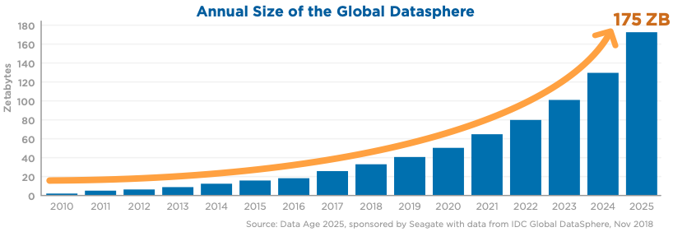

Data Driven World
79 Zettabytes in 2021
DARK DATA
NOT STORABLE DATA
Notes:
- HUMAN vs COMPUTER generated data
Problems arised for this large ammount
Dark data not processed (don’t know wha to do and there is no compute caability)
Non storable (not enough storage devices)
Everest a project to improve the efficiency in data computation

Slide 5
Outline
Everest Use Cases
Everest Target Architectures
Everest System Development Kit
Notes:
Everest a project to improve the efficiency in data computation

Slide 6
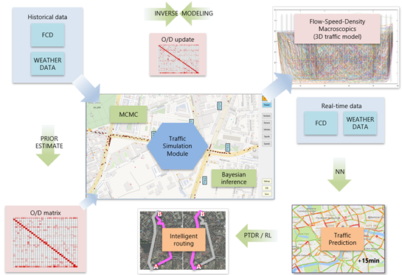
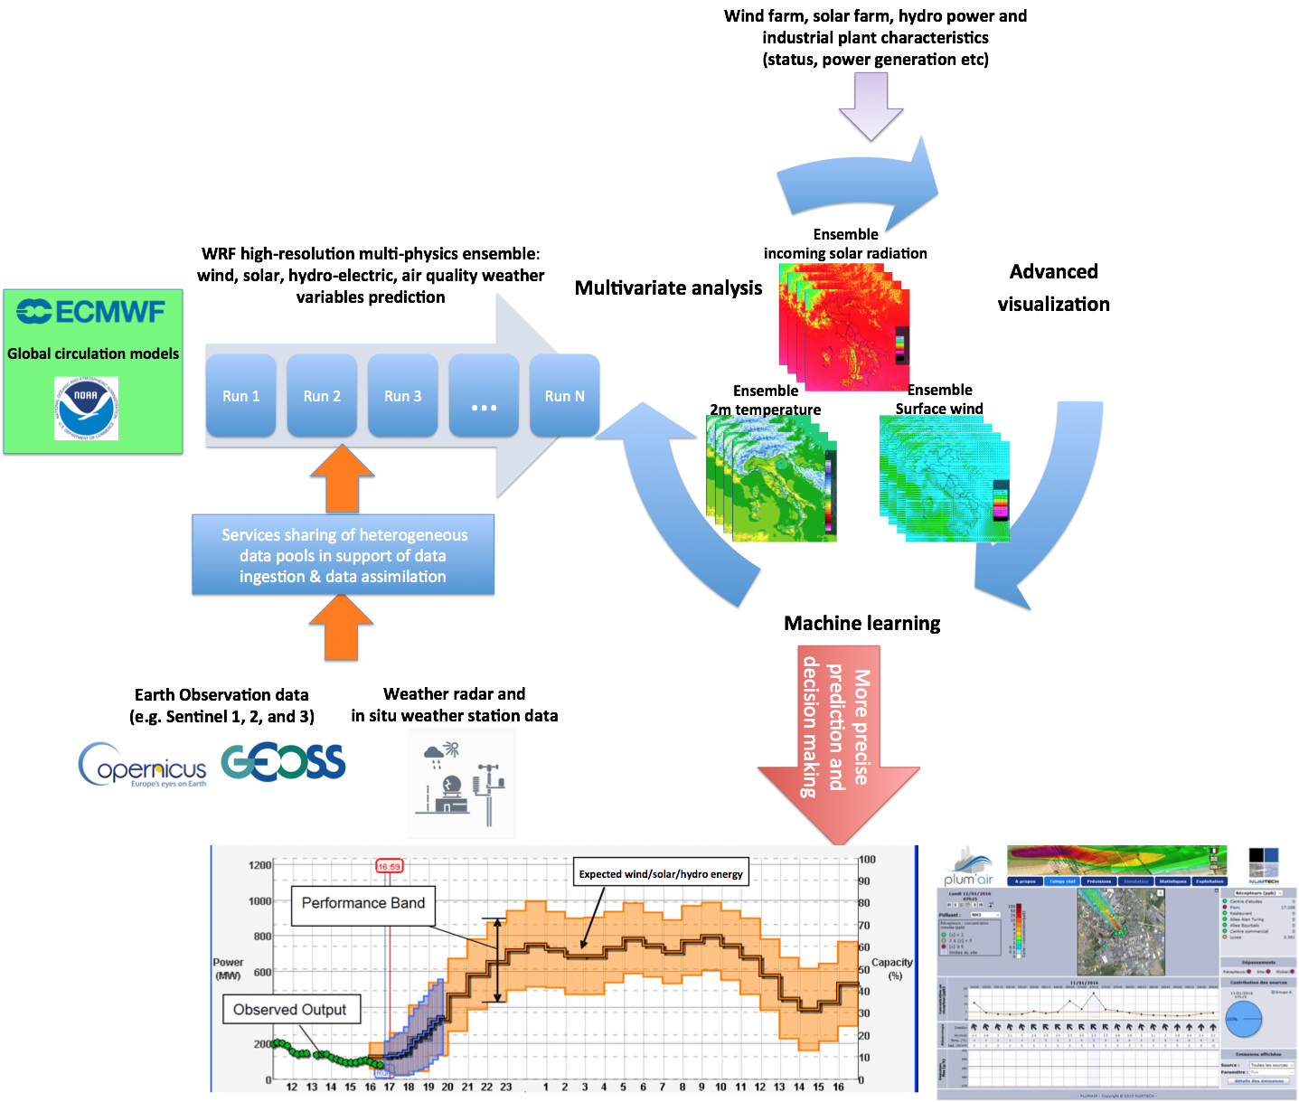
Everest Use Cases: Application Concepts
Three use cases provided by the application partners
Looking for hardware acceleration (intense data computation) with efficient and secure data management (distributed data sources)
Possibility of AI/ML-based decision making
Combination of tasks in different pipelines
(creation of "scientific services")
Traffic modelling for intelligent transportation
Air-quality monitoring in industrial sites
Weather-based prediction of renewable energy production
Notes:
WS _ Data driven application for Industrial and social challanges … Context
HW accelleration as a constant request
All have an ML based part as most of the nowadays workloads
All have complex pipelines not just a single task processing

Slide 7
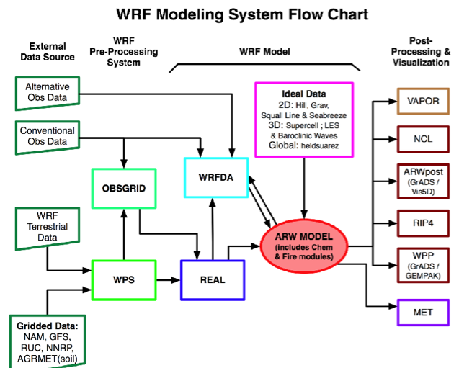

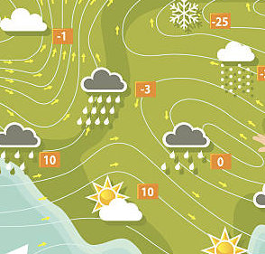


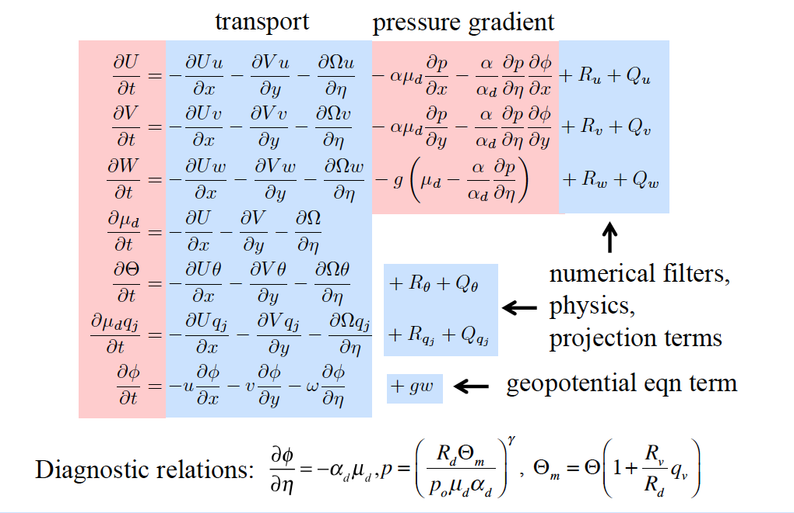
The WRF Model
First step of two use cases…
WRF is an collaborative open source model supported principally by the US National Center for Atmospheric Research (NCAR), the US National Oceanic and Atmospheric Administration and the US National Center for Environmental Prediction – NCEP)

Slide 8
The WRF Model
First step of two use cases…
WRF is an collaborative open source model supported principally by the US National Center for Atmospheric Research (NCAR), the US National Oceanic and Atmospheric Administration and the US National Center for Environmental Prediction – NCEP)
CHALLANGES
Automatic deployment of several instances of the model in HPC resources with multiple boundaries conditions
Efficient High Resolution output evaluating the usage of FPGA resources

Slide 9
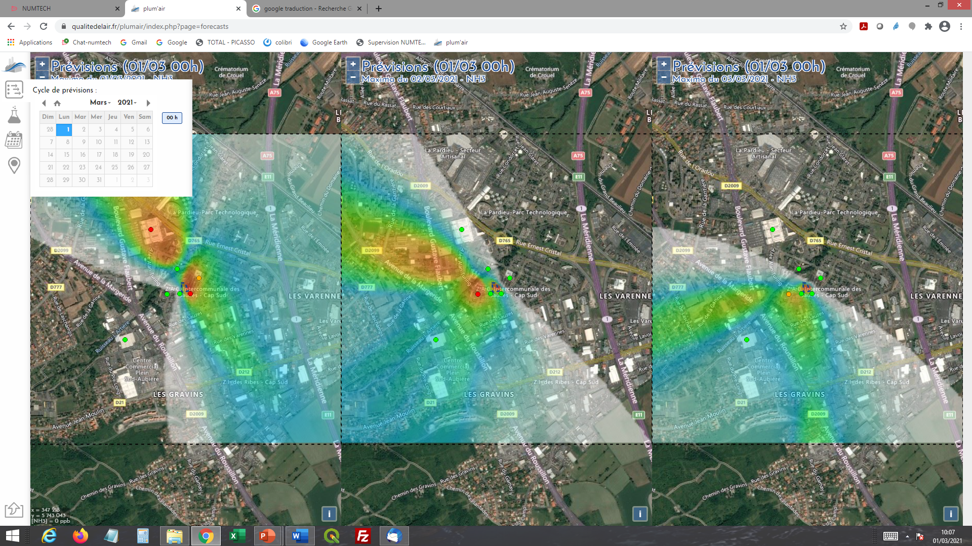
Air-quality use case: General context
Platform to predict the air quality of industrial sites
If predicted impacts exceeds some concentration levels, the industrial site may adapt its production, activate some emission reduction process, …
  Action = Financial cost
  Objectives :
    Minimize false predicted peaks
    Optimize real predicted peaks
One key part is the meteorological forecast part
Site specific predictions

Slide 10
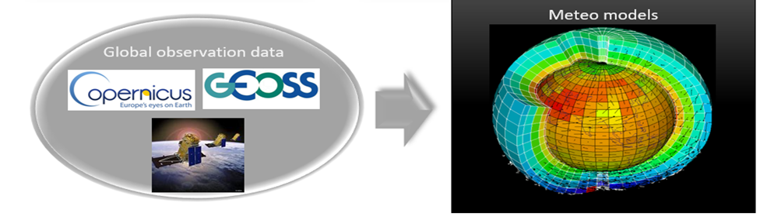
Air-quality use case: Workflows and Challenges
1. WRF Deterministic weather forecast
Global
observation
WRF
execution
Improve speed to produce forecast
Notes:
-request on WRF, faster means more predictions and finer grain

Slide 11
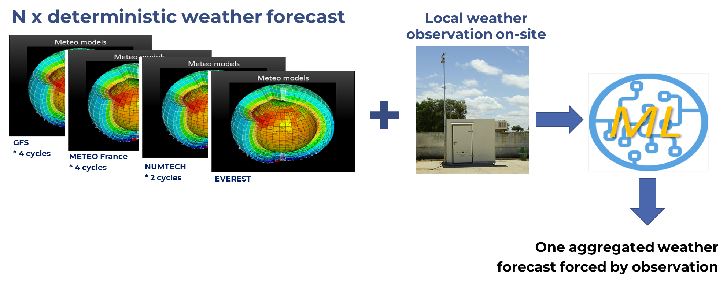
Air-quality use case: Workflows and Challenges
1. WRF Deterministic weather forecast
Global
observation
WRF
execution
Improve speed to produce forecast
2. Ensemble weather aggregation
Improve quality of local weather forecast
Notes:
feed Prediction with multiple sources and also local sensor to improve the quality

Slide 12
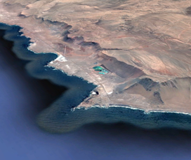
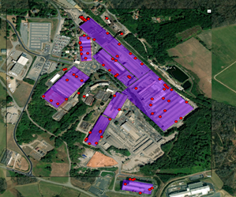

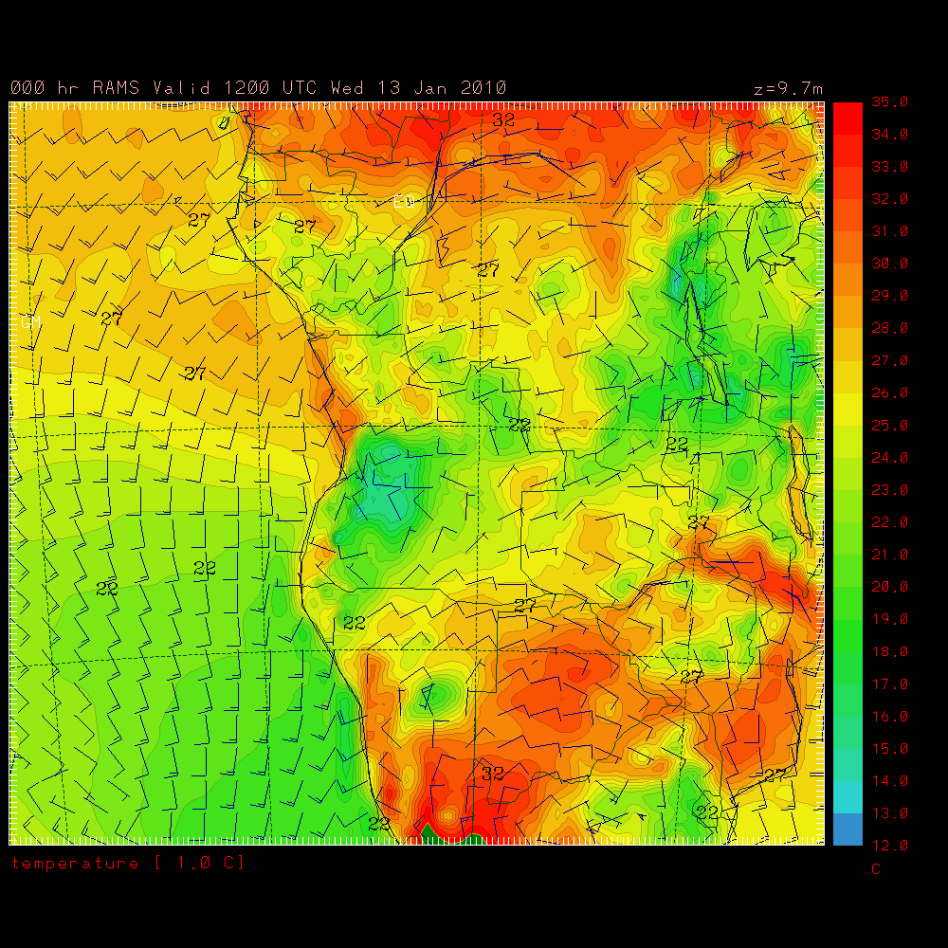


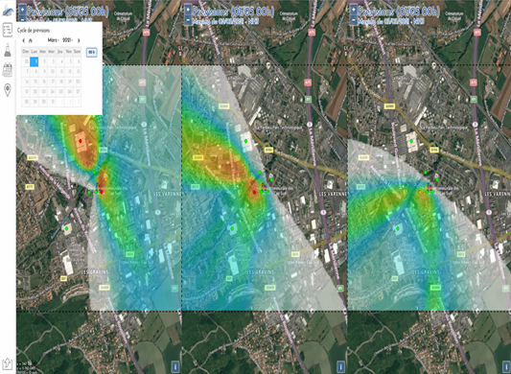
Air-quality use case: Workflows and Challenges
1. WRF Deterministic weather forecast
3. Air-quality dispersion forecast
Global
observation
WRF
execution
Landuse, Topography
Industrial
site data
Emission forecast
Local weather
forecast
Improve speed to produce forecast
2. Ensemble weather aggregation
Air-quality forecast
Improve quality of local weather forecast
Improve speed to produce air-quality forecast and its quality
Notes:
- final workflow that takes the output of the #2 and many other sources and produces the air quality fforecast

Slide 13
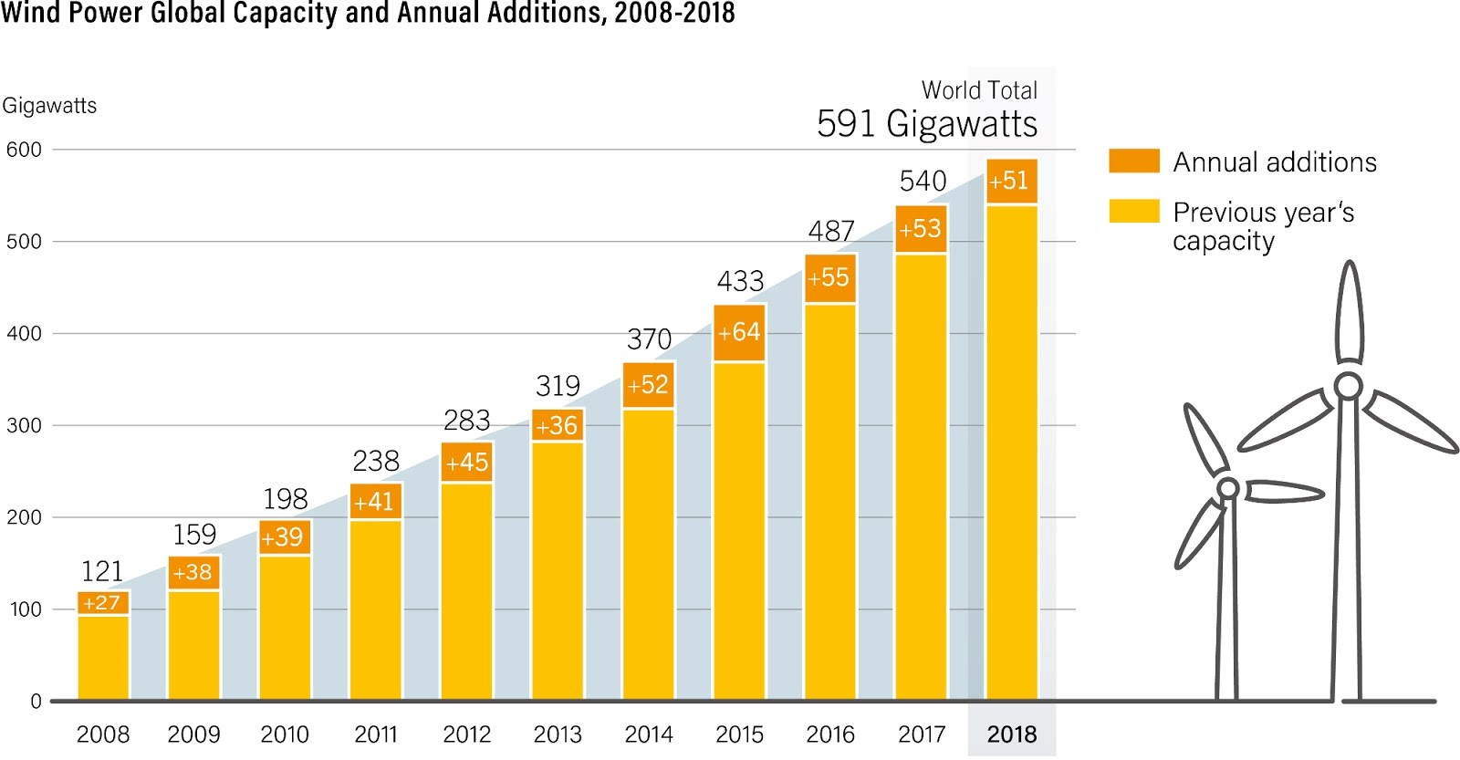
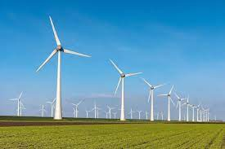
Renewable Energy use case: Context and Challenge
Effort to improve the Wind Power Forecast accuracy
Different challenges due to intermittency of the wind power generation:
  Transmission System Operator (in Italy TERNA) to ensure the balance of grid (very short term horizon: 1s to 1h)
  Traders to forecast the power to sell on energy market, intraday or day ahead (short term horizon: 1h to 24h)
  Wind farm owners to schedule their maintenance programs (long term horizon)
Notes:
2° Use case based on Rene

Slide 14
Renewable Energy use case: Context and Challenge
Different challenges due to intermittency of the wind power generation:
  Transmission System Operator (in Italy TERNA) to ensure the balance of grid (very short term horizon: 1s to 1h)
  Traders to forecast the power to sell on energy market, intraday or day ahead (short term horizon: 1h to 24h)
  Wind farm owners to schedule their maintenance programs (long term horizon)
  → great effort to improve the Wind Power Forecast accuracy
CHALLENGES:
Integration of the the data coming from sensors available on wind turbine for improving weather forecast model
Extend the wind speed estimation at 80m instead of the 10m default in WRF to improve prediction capabilities
Adopt AI models to learn and predict power generated by the specific site/turbine given historical data
… making use of Heterogeneous Resources when needed
Notes:
Fine grain informations coming from the WIND FARM
- Turbines require calibration

Slide 15
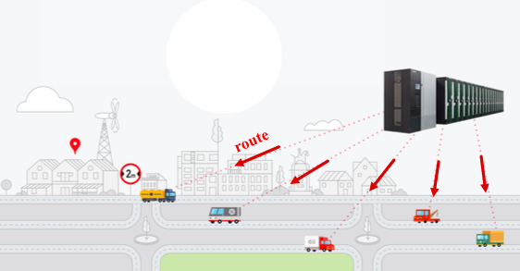

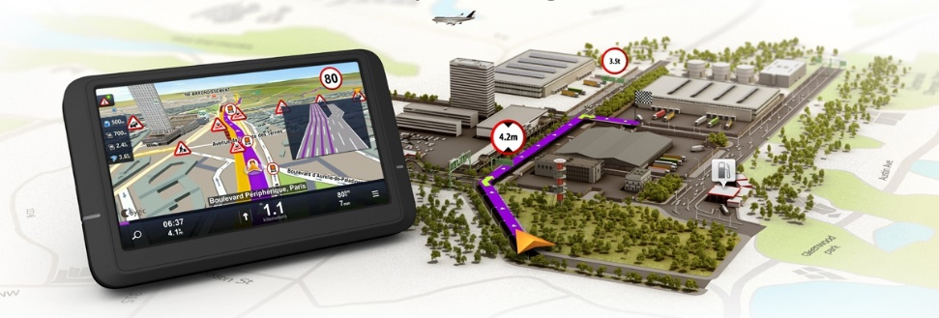
Advance Traffic Modeling for Smart Cities use case
Mobility platform for supporting cities with advanced traffic modelling
Data sources
  Historical and real-time Floating Car Data (FCD)
    e.g. GPS position, timestamp and speed
  Origin-destination matrix (ODM) defining city
  Road network graph including road restrictions;
  Historical weather data (temperature, precipitation)
Traffic services
  What-if analysis for given scenarios, e.g. road closure;
  Intelligent routing for large amount of vehicles
  Traffic prediction for major road elements of cities
Notes:
5seconds Historical data
WRF not included in this use case but possible

Slide 16
Advance Traffic Modeling for Smart Cities use case
Mobility platform for supporting cities with advanced traffic modelling
Data sources
  Historical and real-time Floating Car Data (FCD)
    e.g. GPS position, timestamp and speed
  Origin-destination matrix (ODM) defining city
  Road network graph including road restrictions;
  Historical weather data (temperature, precipitation)
Traffic services
  What-if analysis for given scenarios, e.g. road closure;
  Intelligent routing for large amount of vehicles
  Traffic prediction for major road elements of cities
CHALLENGES:
Boost the FCD data collection and processing to compute 3D traffic models
Develop and efficiently deploy a traffic simulator on a multinode architecture to predict traffic behaviour
Adopt AI techniques to learn the traffic patterns resulting into a traffic prediction service.
… making use of Heterogeneous Resources

Slide 17
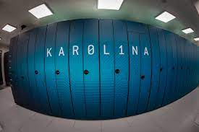
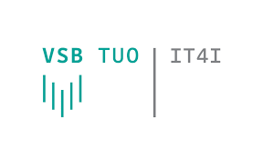
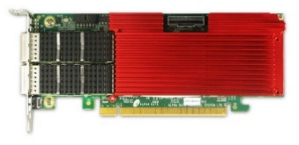
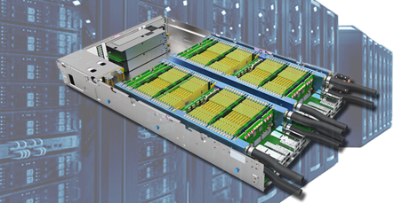
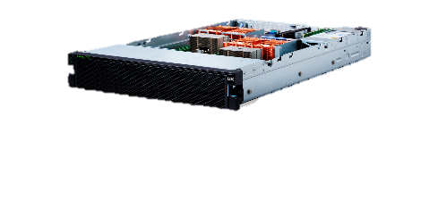
EVEREST Target System: Brief Overview
Datacenters and Supercomputer infrastructures
Network-attached and PCIe-attached FPGSd architectures:
Off-the-shelf FPGA devices
User logic can be easily designed and customized with traditional HLS tools
FPGA as a Co-Processor
FPGA as a Peer-Processor
PCIe

Slide 18
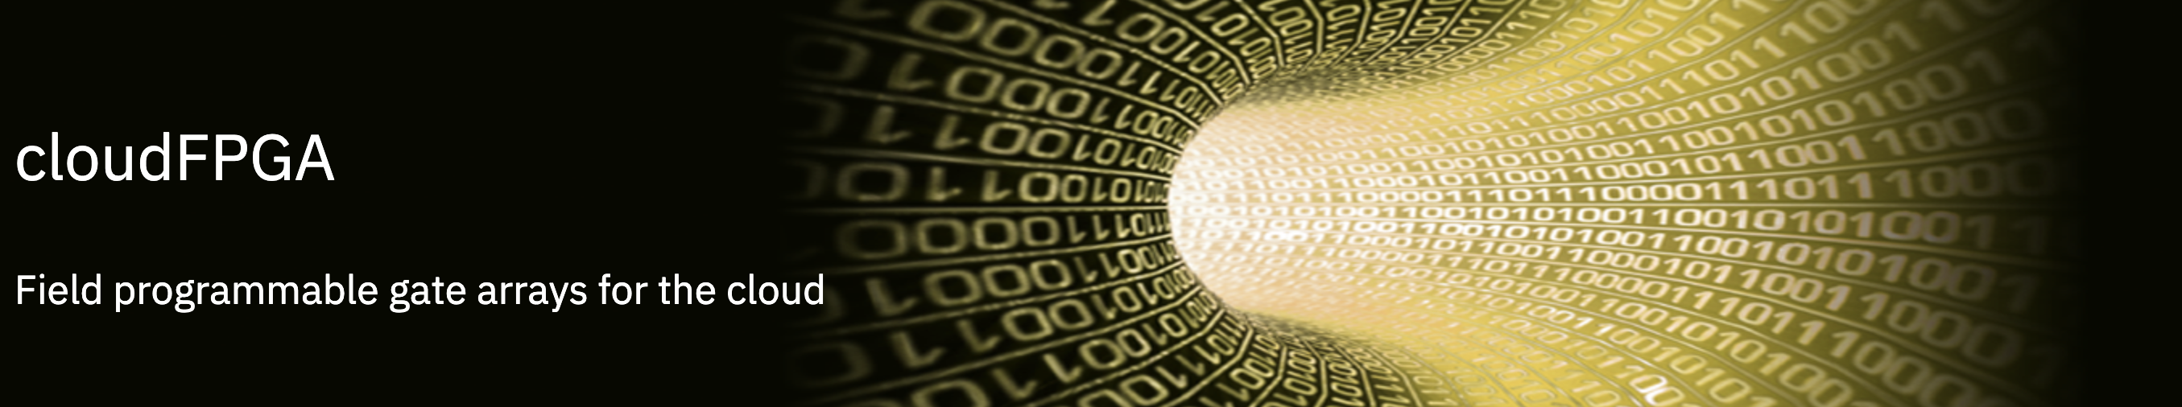
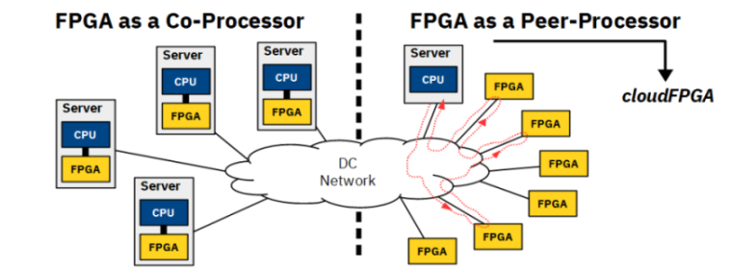
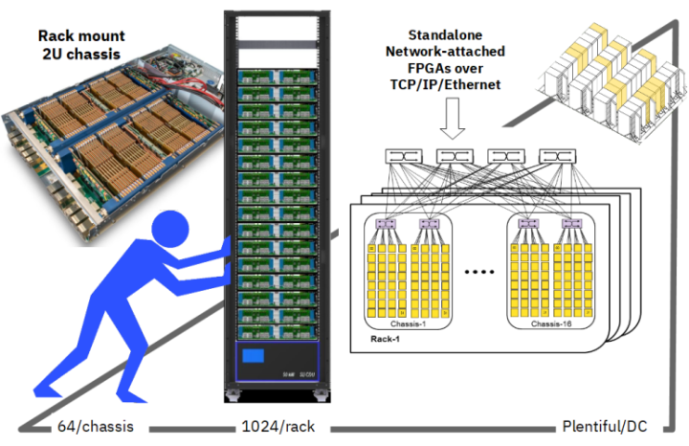
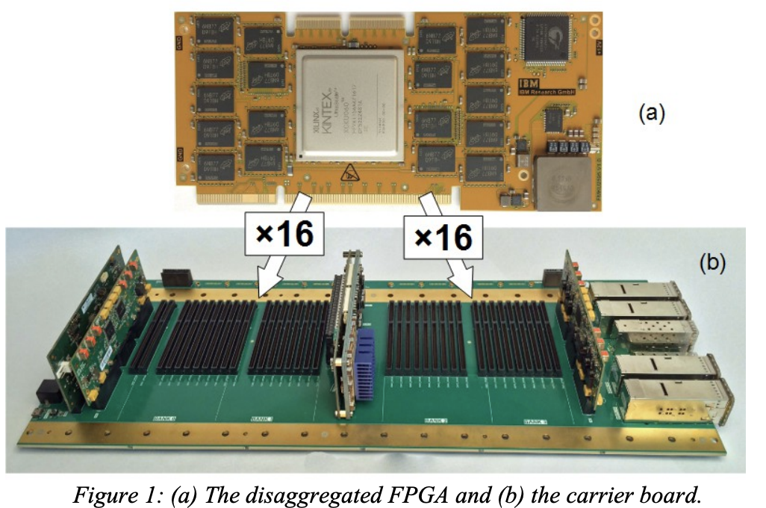
cloudFPGA
FPGA as a 1st class citizen within a DataCenter (DC):
FPGA disaggregated from the server nodes
FPGAs connected directly to the DC network for its access and to communicate with CPUs and other FPGAs
FPGAs are den densely packed into DC chassis and racks and distributed across the DC
Xilinx Kintex UltraScale XCKU060 FPGA with 2x8GB of DDR4 memory
F. Abel, et al. "An FPGA Platform for Hyperscalers", HOTI
B. Ringlein, et al. “A Case for Function-as-a-Service with Disaggregated FPGAs,” CLOUD
Notes:
Field programmable gate arrays (FPGAs) are making their way into data centers (DC
The cloudFPGA system is built on three main pillars:
- the use of standalone network-attached FPGAs,
- a hyperscale infrastructure for deploying the above FPGAs at large scale and in a cost-effective way,
- an accelerator service that integrates and manages the standalone network-attached FPGAs in the cloud.

Slide 19
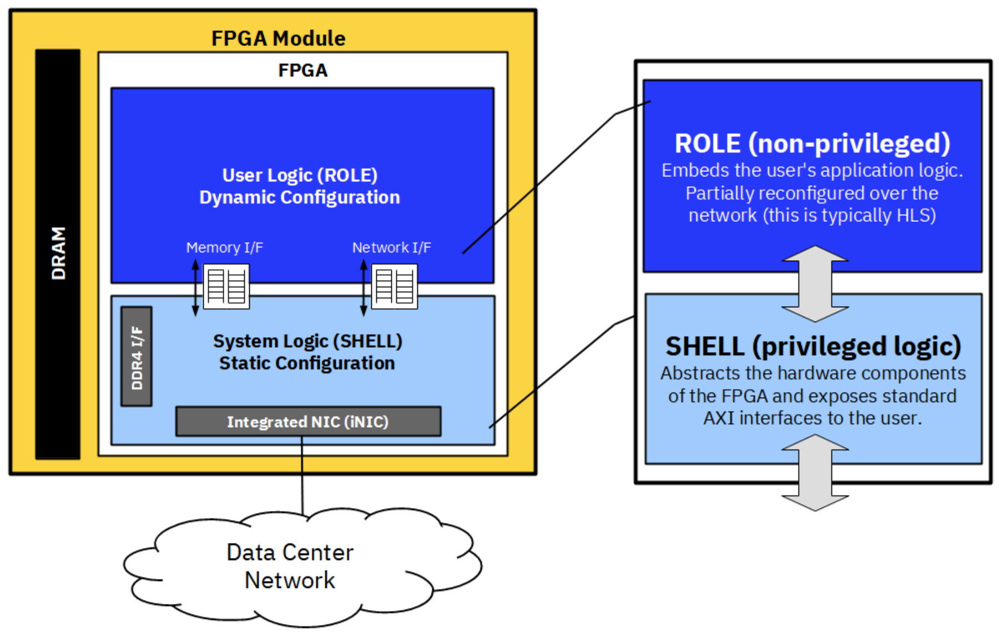
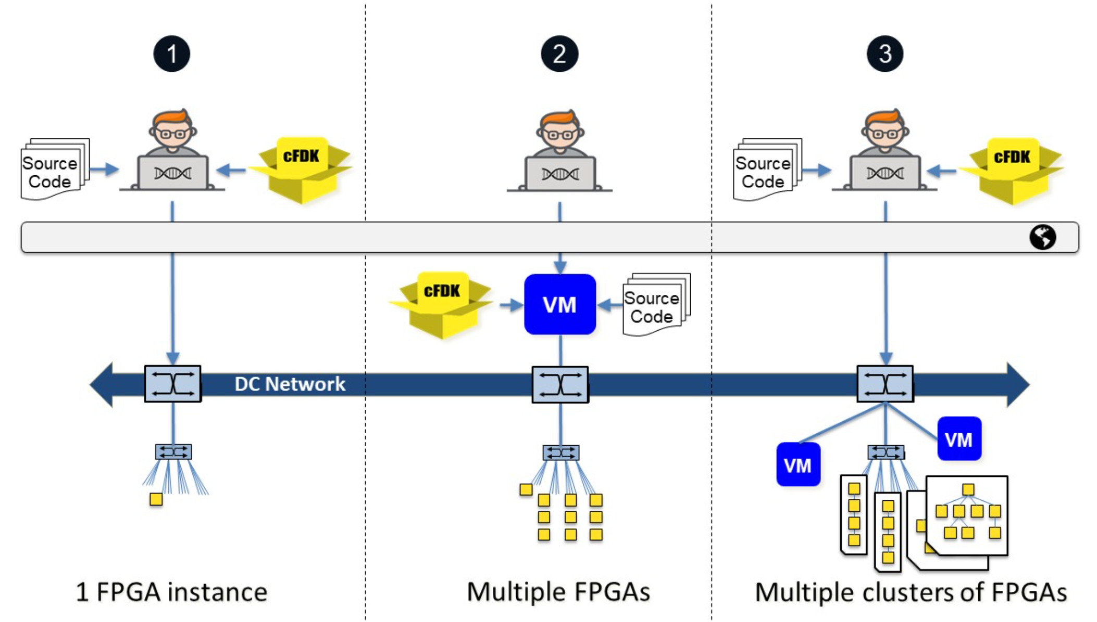
cloudFPGA: Key Features
Network-attached solution composed of:
  Interface logic already designed (cF Shell) to support system integration
    TPC/UDP communication is managed transparently to the user logic
  User logic (ROLE) that can be easily designed and customized with traditional HLS tools
Application code running on host
  FPGA accessible through the network
  Low-level libraries for host-FPGA
  communication
Possibility to instanciate a cluster of FPGAs
IDE and custom tools for allocation and management of resources
cFDK released
https://github.com/cloudFPGA

Slide 20

Climbing EVEREST: Obstacles on the Road
Programmability: Application developers have often limited hardware skills and limited knowledge of the target platform
How to specify the application functionality to get the best results?
How to design the hardware accelerator and the memory
subsystem not only to optimize the performance but also to
respect resource constraints
Portability: Designing a FPGA system is hard, but
designing an application for many systems is
even harder
How to specify a platform-agnostic functionality?
How to match such functionality with the actual
hardware?
How to deal with dynamic changes?
Notes:
NICE USE CASES NICE PLATFORM… BUT HOW TO MATCH THEM
DSL & High-level synthesis tools
Runtime and virtualization

Slide 21
EVEREST SDK: SYSTEM Development Kit
Coordinated design environment composed of four major phases:
Application specification (data ▻ application and requirements)
Architecture abstraction (target system ▻ arch. description)
Programming environment (app+arch+reqs desc. ▻ hw/sw bin.)
Execution monitoring and management (hw/sw bin. ▻ execution)

Slide 22
EVEREST Programming Environment
Compilation Environment: analyzes application and creates all "variants" based on architecture abstraction and application/data requirements
Integration of functional description and non-functional properties with DSL extensions
Unified IR framework (MLIR) to support different
inputs
  Support for custom DSL and existing ML frameworks
Interoperability of HLS tools (Bambu, VivadoVitis HLS)
"Intelligent" memory managers to coordinate data
transfers (Mnemosyne)
Multitarget system integration for different FPGAs (Olympus, cFDK)
Creation of bitstreams and binaries to be deployed onto the target platform hiding its complexity
Notes:
The first of two pillars
Starts from different DSLs for functional/extra functional specification
Converge towards a single IR
Generated binary includes multiple variants

Slide 23
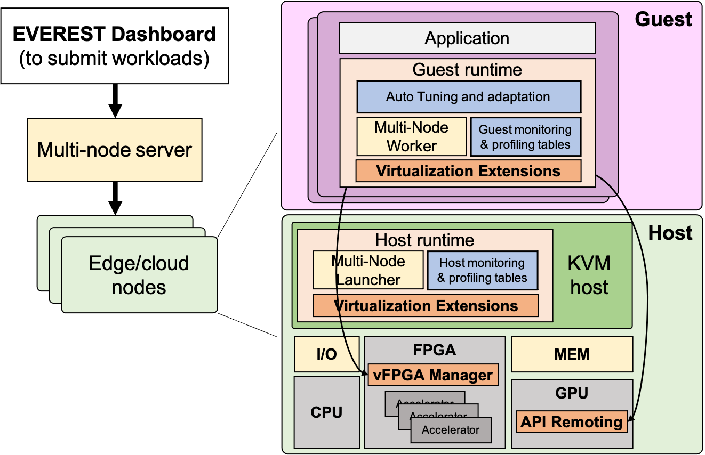
EVEREST Runtime Environment
Runtime Environment: implements
the dynamic selection of "variants"
and the hardware configuration based
on the system status
Two-level runtime to support
  (1) virtualization of hardware resources regardless their distribution and the low-level details of the platforms;
  (2) Application-level functional decisions
  (a) mARGOt for dynamic adaptation and autotuning
  (b) HyperLoom/Hyperqueue for multinode management (scheduling and resource allocation)
Automatic deployment and configuration on the (cloud) FPGA resources
Notes:
the second pillar even if smaller than the previous one

Slide 24
Conclusions
EVEREST is an H2020 project that aims at simplyfing the use of FPGA for the acceleration of Big Data applications
Three application use cases: weather-based renewable energy prediction, air-quality monitoring of industrial sites, and intelligent traffic management
Data-centric approach focusing on the combination of domain-specific and data-oriented extensions, high-level synthesis, and dynamic adaptivity
CloudFPGA and Alveo-based clusters will be used as acceleration platforms
Looking for interoperability with existing solutions
EVEREST SDK will be released as open-source to the community
The main goal is to simplify the description of complex Big Data applications and improve the programmability of distributed FPGA-based systems
!!! Many piecies available, the global picture is not composed yet !!!
Stay tuned on http://www.everest-h2020.eu

Slide 27

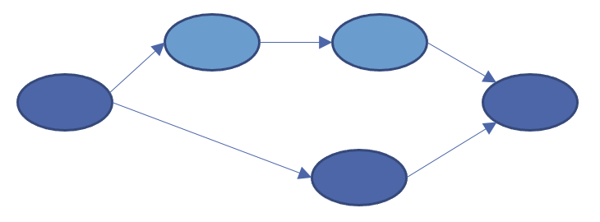
Hardware Compilation Flow
Job Code
Job Code
Job Code
Untouched code
Untouched code
Untouched code
Job Code
Job Code
Job Code
Compiler
Compiler
Compiler
exec
exec
exec

Slide 28
Hardware Compilation Flow
HyperTools
Job Code
Job Code
Job Code
Untouched code
Untouched code
Untouched code
Job Code
Job Code
Job Code
Compiler
Compiler
Compiler
exec
exec
exec

Slide 29
Hardware Compilation Flow
HyperTools
MLIR Dialect
MLIR Dialect
MLIR Dialect
Job Code
Job Code
Job Code
DSL
Encapsulated in functions
MLIR
Compiler
(embedded) DSLs
Untouched code
Untouched code
Untouched code
Job Code
Job Code
Job Code
Compiler
Compiler
Compiler
exec
exec
exec

Slide 30
Hardware Compilation Flow
HyperTools
MLIR Dialect
MLIR Dialect
MLIR Dialect
Job Code
Job Code
Job Code
DSL
Encapsulated in functions
MLIR
Compiler
Annotated C code / MLIR
(embedded) DSLs
IP requirements
Memory access patterns
Arch. Info
Mem. Info
Security/data requirements
Untouched code
Untouched code
Variants configuration
Security/data requirements
Untouched code
Code variants
Job Code
Job Code
Updated code
mARGOt generator
IP config.
Mem. Gen. (Mnemosyne)
HLS (Bambu/Vitis)
Compiler
Compiler
Compiler
exec
exec
exec

Slide 31
Hardware Compilation Flow
HyperTools
MLIR Dialect
MLIR Dialect
MLIR Dialect
Job Code
Job Code
Job Code
DSL
Encapsulated in functions
MLIR
Compiler
Annotated C code / MLIR
(embedded) DSLs
IP requirements
Memory access patterns
Arch. Info
Mem. Info
Security/data requirements
Untouched code
Untouched code
Variants configuration
Security/data requirements
Untouched code
Code variants
Job Code
Job Code
Updated code
mARGOt generator
IP config.
Mem. Gen. (Mnemosyne)
HLS (Bambu/Vitis)
Hw/SW variant integration
Compiler
Compiler
Compiler
System Integration (Olympus/cFDK)
Sw monitors
Hw monitors
HDL code (ROLE)
User-defined
exec
exec
exec
bitstreams
FPGA tools
HDL code (SHELL)
Provider-defined (cloudFPGA, OCAPI, ...)

Slide 32
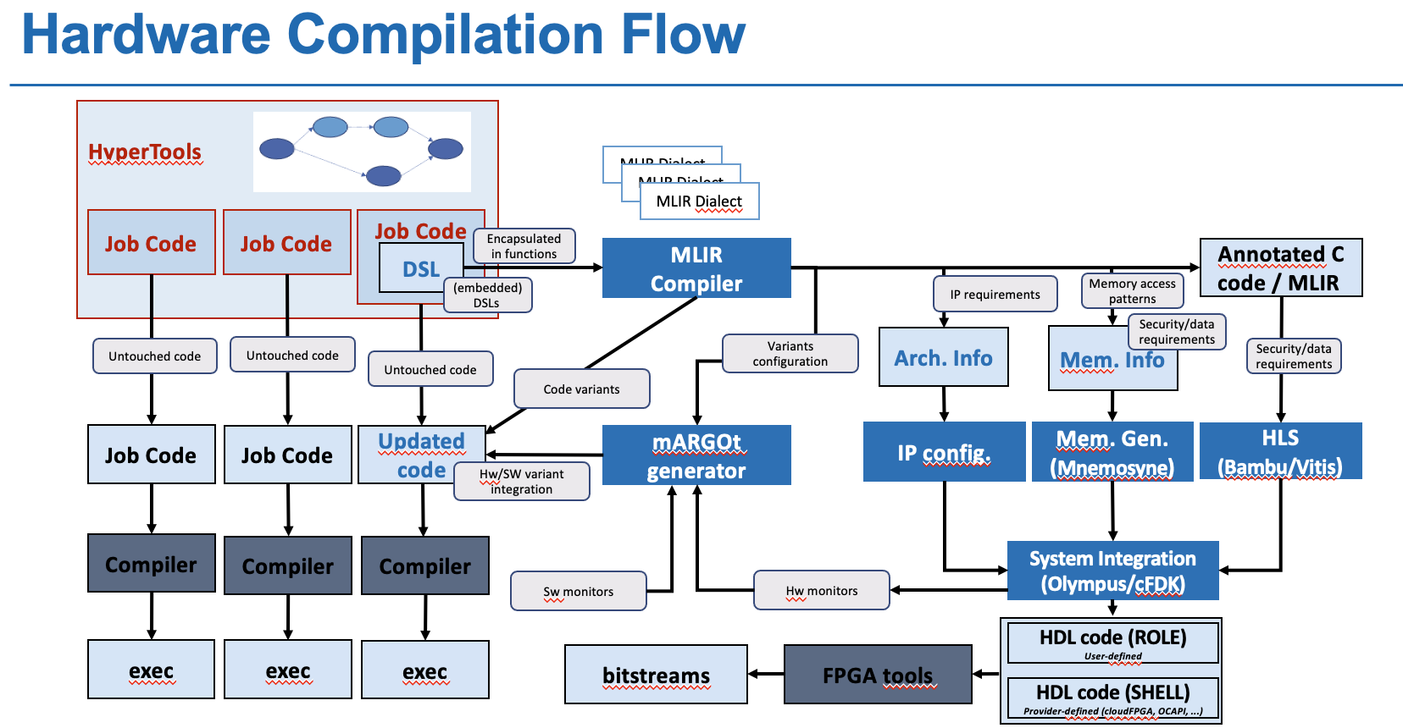
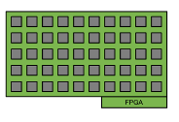
RunTime Management: Overview
V1 V2 V3
Job Code

Slide 33
RunTime Management: Overview
V1 V2 V3
Job Code
EVEREST NODE
Job Submission via HyperQueue

Slide 34
RunTime Management: Overview
VM1
V1 V2 V3
Job Code
V1 V2 V3
Dynamic Tuner Select Version
Job Code
EVEREST NODE
HyperTools and VM Manager Assign Resources

Slide 35
RunTime Management: Overview
VM1
VM2
V1 V2 V3
V1 V2 V3
Job Code
Job Code
V1 V2 V3
Job Code
EVEREST NODE
HyperTools and VM Manager Assign Resources
PriorityVM1> PriorityVM2

Slide 36
RunTime Management: Overview
VM1
V1 V2 V3
Job Code
V1 V2 V3
Job Code
EVEREST NODE

Slide 37
RunTime Management: Overview
VM1
VM2’
V1 V2 V3
V1 V2 V3
Job Code
Job Code
V1 V2 V3
Job Code
EVEREST NODE
VM Management Permits Hot Swap of FPGA
PriorityVM1 < PriorityVM2’

Slide 38
RunTime Management: Overview
VM1
VM2’’
V1 V2 V3
V1 V2 V3
Job Code
Job Code
V1 V2 V3
Job Code
EVEREST NODE
VM Management permits the abstraction of HW accellerators on FPGA
PriorityVM1 = PriorityVM2’’

