Slide 1

EVEREST: A design environment for extreme-scale big data analytics on heterogeneous platforms
Christian Pilato², Stanislav Bohm⁶, Fabien Brocheton⁹, Jeronimo Castrillon⁴, Riccardo Cevasco⁸, Vojtech Cima⁶,
Radim Cmar¹⁰, Dionysios Diamantopoulos¹, Fabrizio Ferrandi², Jan Martinovic⁶, Gianluca Palermo², Michele Paolino⁷,
Antonio Parodi⁵, Lorenzo Pittaluga⁸, Daniel Raho⁷, Francesco Regazzoni³, Katerina Slaninova⁶, Christoph Hagleitner¹
¹IBM Research Europe, Switzerland, ²Politecnico di Milano, Italy, ³Università della Svizzera italiana, Switzerland,
⁴Technische Universitat Dresden, Germany, ⁵Centro Internazionale di Monitoraggio Ambientale, Italy,
⁶IT4Innovations, VSB – Technical University of Ostrava, Czech Republic, ⁷Virtual Open System, France,
⁸Duferco Energia, Italy, ⁹NUMTECH, France, ¹⁰Sygic, Slovakia
4 February 2021 - Multi-Partner Innovative Research Projects @ DATE 2021

Slide 2
EVEREST: Big Data Analytics on FPGA
H2020 project funded under the call – "Big Data technologies and extreme-scale analytics" [Kick-off on Oct 1, 2020]
Project Coordinator: Christoph Hagleitner, IBM Research Zurich
Scientific Coordinator: Christian Pilato, Politecnico di Milano
Key idea:
a coordinated action with the appropriate technology areas (e.g., AI, analytics, software engineering, HPC, Cloud technologies, IoT and edge/fog/ubiquitous computing) ➔ Computing continuum to enable cloud-to-edge integration
system engineering/tools to contribute to the co-design of federated/distributed systems ➔ EVEREST system development kit
architectures for collecting, managing and exploiting
virtualization
hardware acceleration
data security
standardized interconnection methods
runtime management
We can use AI/ML to optimize data analytics and knowledge extraction, but this is not strictly an AI/ML-related project!
domain-specific extensions

Slide 3










EVEREST Partners
IBM Reseach Lab, Zurich (Switzerland)
Project Administration, Prototype of the target system
Politecnico di Milano (Italy)
Project Administration, High-Level System, Flexbile Memory Manager, Autotuning
Università della Svizzera italiana (Switzerland)
Data security requirements and protection techniques
TU Dresden (Germany)
Domain-specific extensions, code optimizations and variants
Centro Internazionale di Monitoraggio Ambientale (Italy)
Weather prediction models
IT4Innovations (Czech Republic)
Exploitation leaders, Large HPC infrastructure, Workflow libraries
Virtual Open Systems (France)
Virtualization techniques, runtime extensions to manage
heterogeneous resources
Duferco Energia (Italy)
Application for prediction of renewable energies
Numtech (France)
Application for monitoring the air quality of industrial sites
Sygic A/S (Slovakia)
Application for intelligent transportation in smart cities

Slide 4
EVEREST SDK: System Development Kit
Four major phases:
Application specification (data ▻ application and requirements)
Architecture abstraction (target system ▻ arch. description)
Programming environment (app+arch+reqs desc. ▻ hw/sw bin.)
Execution monitoring and management (hw/sw bin. ▻ execution)

Slide 5
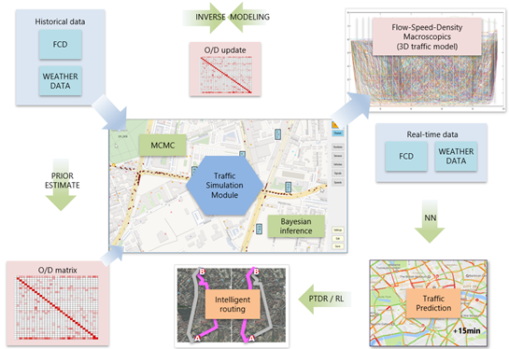
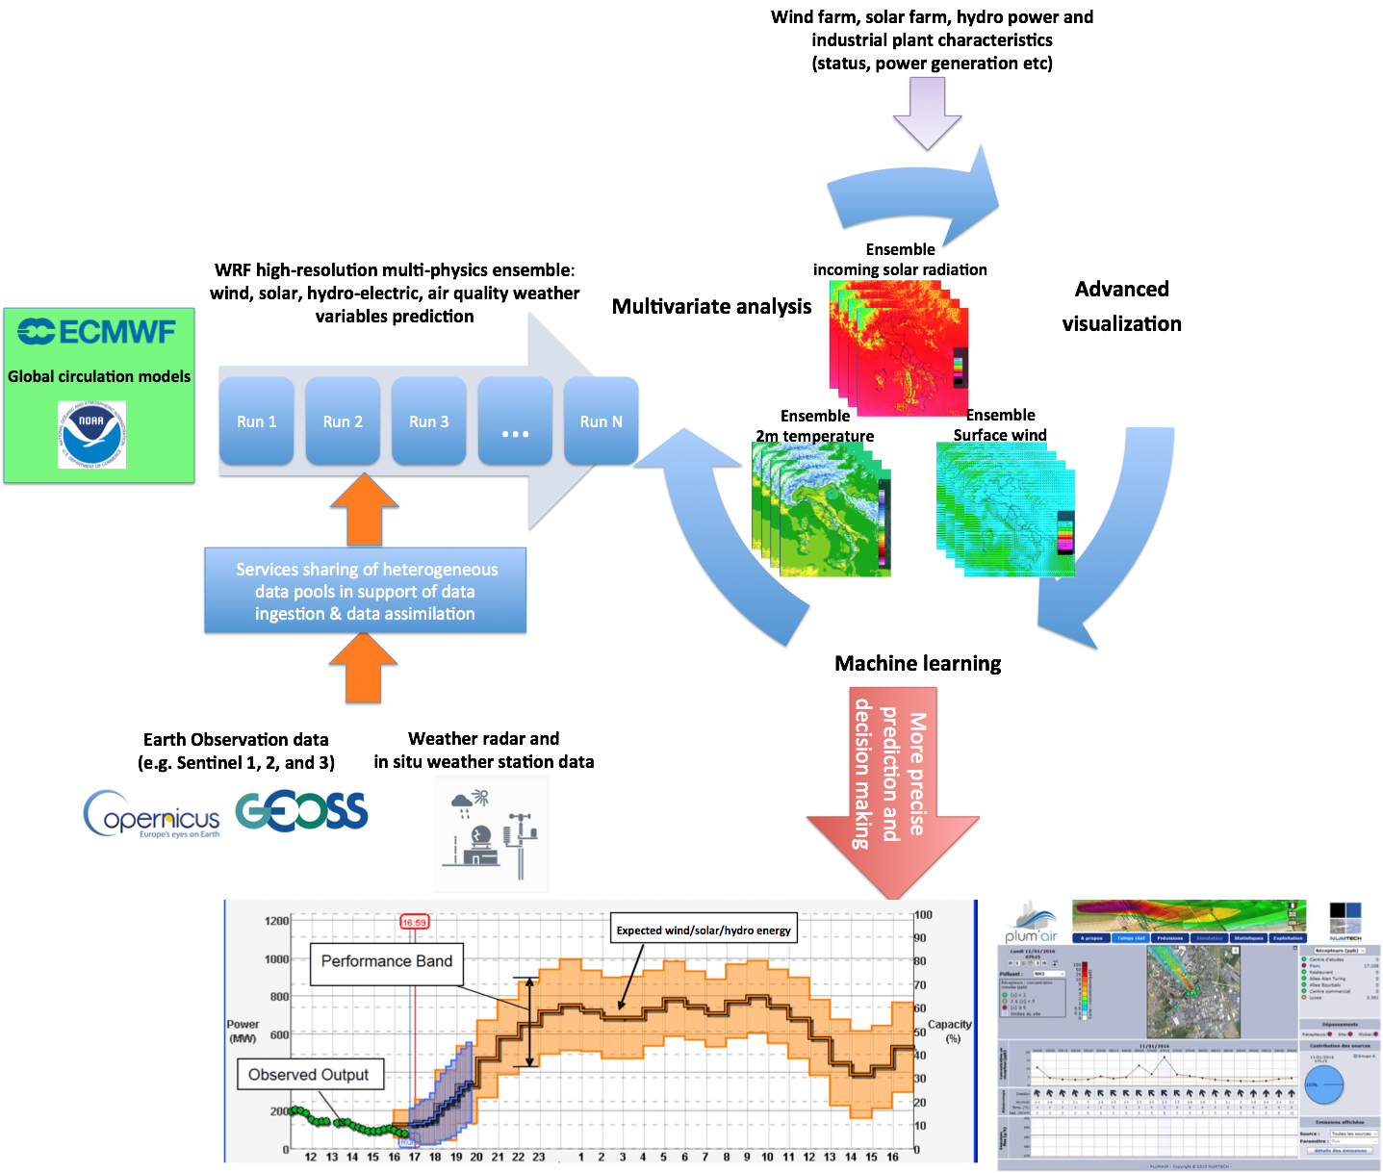
Application Concepts
Three use cases provided by the application partners
Looking for hardware acceleration (intense data computation) with efficient and secure data management (distributed data sources)
Possibility of AI/ML-based decision making
Combination of the tasks in different pipelines
Air-quality monitoring in industrial sites
Traffic modelling for intelligent transportation
Weather-based prediction of renewable energy production

Slide 6
Data, Applications and Benchmarks
Research data
Format, sources, size, access patterns: key elements for efficient optimization
Available for Open Research Data: "for managing the data generated and collected during the project"
Coordinated action for application description
Functionality specification (Spark, HyperLoom, ML frameworks)
  Specification languages, format of workflow pipelines & kernels (C/C++, DSL)
  Non-functional properties (e.g., security requirements) (DSL, Annotations)
Execution model (HyperLoom, VoSys Runtime, Platform libs)
  Interaction with the platform/runtime (bottom-up: abstraction of arch. details and top-down: implementation of app. functionality)

Slide 7
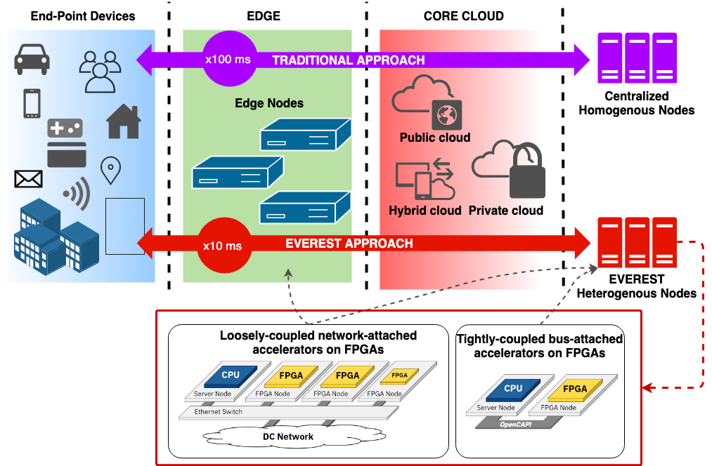
EVEREST Target System
Computing continuum to enable cloud-to-edge integration
We aim at outperforming centralized/homogeneous solutions
How to combine different technologies?
Physically: Connectivity
Logically: Virtualization and dynamic adaptation
FPGA-based heterogeneous architectures (HLS and hardware acceleration)
What to protect? Where? How?
How to specify security req's (DSL)?

Slide 8
EVEREST Target System
Target prototype based on IBM products and internal projects
Combination of CPU-managed systems with tightly-coupled bus-attached FPGAs and FPGA-disaggregated systems with loosely-coupled network- attached FPGAs
Other platforms (e.g., from IT4I and NUM or existing SoCs)
Combination of devices and architectures: Xilinx Alveo, cloudFPGA, Columbia ESP, …
Standard communication formats (e.g., OpenCAPI)
Efficient communication libraries with clear API
Virtualization of resources
Seamless integration of additional EVEREST nodes

Slide 9
EVEREST Programming Environment
Compilation Environment: analyzes
application and creates all "variants"
based on architecture abstraction and
application/data requirements
  (New) Unified IR framework (MLIR)
  Hardware acceleration and High-level
  synthesis (Bambu, Vivado HLS)
  Integration of non-functional properties
  with domain-specific extensions
Standard IR format and exchange files
Novel domain-specific extensions (format)
System and resource description (format)
Possibility of using different (ML) frameworks
Interoperability with different HLS tools

Slide 10
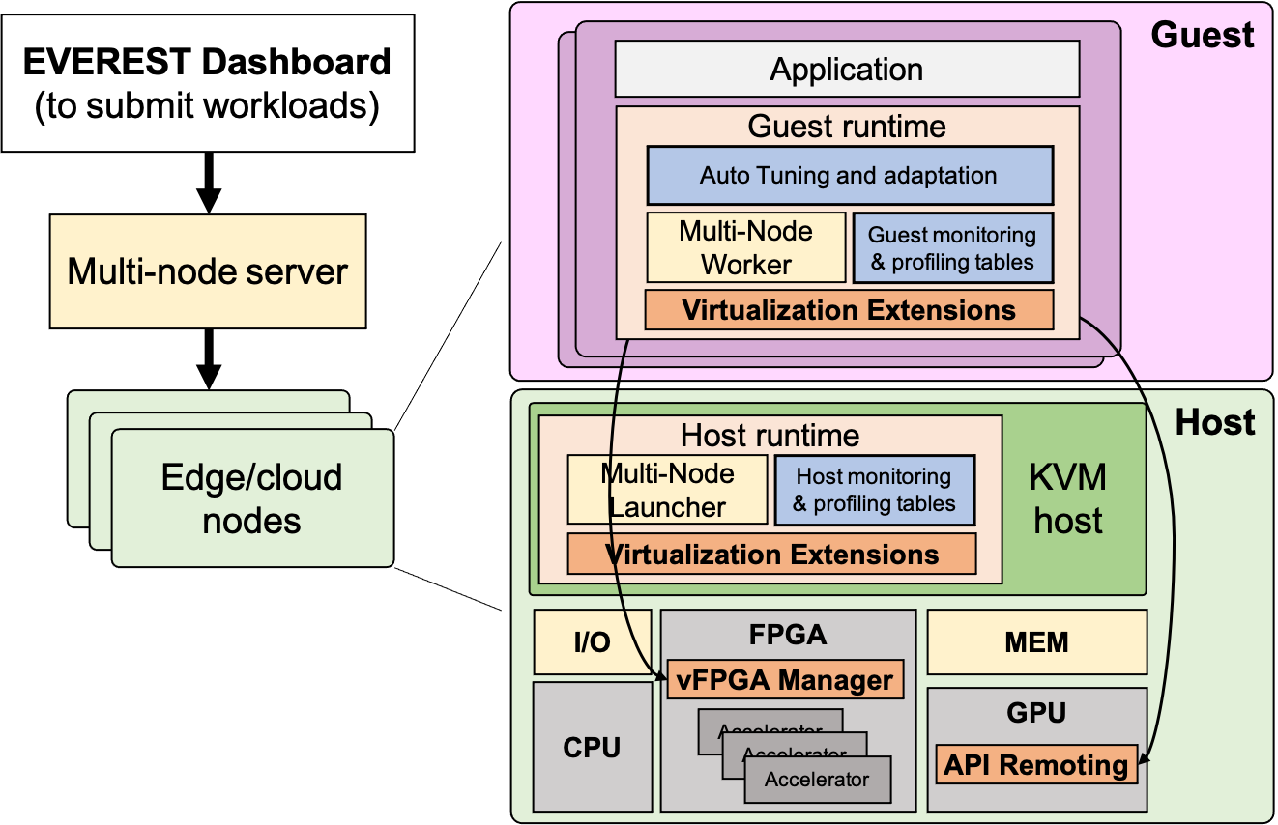
EVEREST Programming Environment
Runtime Environment: implements
the selection of "variants" and the
hardware configuration based
on the system status
  Dynamic adaptation and autotuning
  (mARGOt)
  Two-level runtime for (1) virtualization of
  hardware resources regardless their distribution
  and the low-level details of the platforms; (2) implement
  functional decisions (VOSYS solutions, mARGOt, HyperLoom)
How to collect system status and expose it to the runtime?
Autotuning API
Seamless execution when varying the system configuration (resources, nodes, data, etc.)
Hiding communication latency (e.g., prefetching)
Runtime API

Slide 11
Conclusions
EVEREST is a new H2020 project that aims at enabling FPGA for the optimization of Big Data applications
Data-centric approach focusing on domain-specific extensions, high-level synthesis, and dynamic adaptivity
Three application use cases: weather-based renewable energy prediction, air-quality monitoring of industrial sites, and intelligent traffic management
Looking for interoperability with existing solutions
EVEREST SDK will be released as open-source to the community
The main goal is to simplify the description of complex Big Data applications and improve the programmability of distributed FPGA-based systems

Slide 12

Questions?
Contacts
Christoph Hagleitner, hle@zurich.ibm.com
Christian Pilato, christian.pilato@polimi.it
everest-info@a.alari.ch
This project has received funding from the European Union’s Horizon 2020 research and innovation programme under grant agreement No 957269

